Slide 1
Equations of Motion

Slide 2
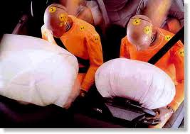
2.25 The human body can survive an acceleration trauma incident (sudden stop) if the magnitude of the acceleration is less than 250 m/s². If you are in a car accident with an initial speed of 105 km/hour and you are stopped by an airbag that inflates from the dashboard, over what distance must the airbag stop you for you to survive the crash?

Slide 3

2.83 Sam heaves a 7.25 shot straight upward, giving it a constant upward acceleration from rest of 11.9 m/s² for 64.0 cm. He releases it 2.2 above the ground. Ignoring air resistance
(a) What is the speed of the shot when Sam releases it?
(b) How high above the ground does it go?
(c) How much time does he have to get out of its way before it returns to a height of the top of his head, 1.83 m above the ground?

Slide 4
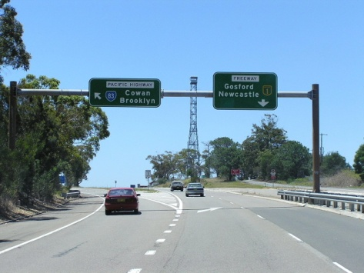
2.26 A car sits in an entrance ramp to a freeway, waiting for a break in the traffic. The driver accelerates with constant acceleration along the ramp and onto the freeway. The car starts from rest, moves in a straight line, and has a speed of 20 m/s when it reaches the end of the 120 m long ramp.
(a) What is the acceleration of the car?
(b) How much time does it take the car to travel the length of the ramp?
(c) The traffic on the freeway is moving at a constant speed of 20 m/s. What distance does the traffic travel, while the car is moving the length of the ramp?

Slide 5
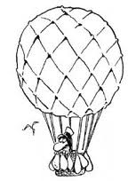
2.04 A hot air balloonist, rising vertically with a constant velocity of magnitude 5.00m/s releases a sandbag at an instant when the balloon is 40.0 m above the ground. After it is released, the sandbag is in free fall.
(a) Compute the position and velocity of the sandbag at 0.25 s after its release.
(a) Compute the position and velocity of the sandbag at 1.00 s after its release.

Slide 6
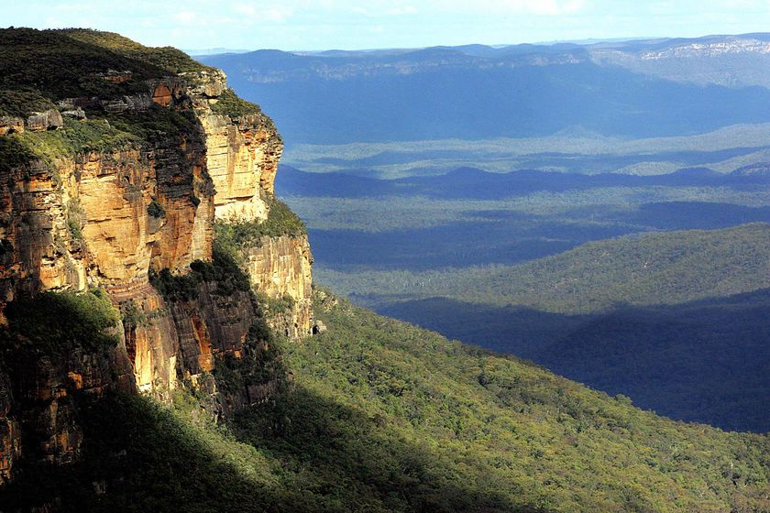
2.88 You are climbing in the Blue Mountains, where you suddenly find yourself at the edge of a fog-shrouded cliff. To find the height of this cliff you drop a rock from the top and 10.0 s later hear the sound of it hitting the ground at the foot of the cliff.
(a) Ignoring air resistance, how high is the cliff, if the time if takes for the sound to return is ignored.

